Slide 1
Chapter12
Object-oriented Design

Slide 2
Revisit OOA
OO = O + O + Interactions
OOA
  Identifies objects in analysis level
  Objects Interaction

Slide 3
Steps for Object-Oriented Analysis
人、事、物和规则
  事—use case, determines objects, its attributes and methods, that is called use case driven.
  规则，determines how objects interact.
  For each use case in the current iteration, you need to:
    Discover candidate objects.
    Describe object interactions.

Slide 4
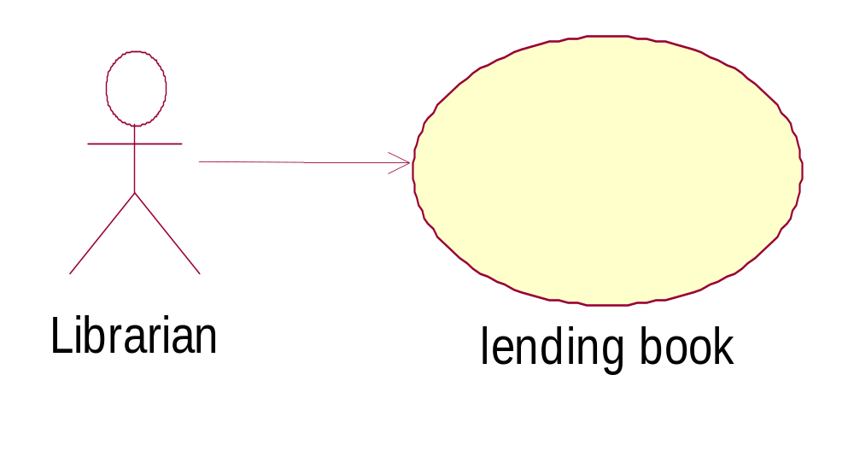
Ongoing example---lending book

Slide 5
Refine use case
Primary scenario of “lending book” use case.
1.Librarian inputs borrower’s information and submit it.
2.System validate information, if invalid, turn to extensio-2a;
3. Librarian enters books information and submit it.
4. System alter this book’s status
5. System process subscription information
6. System record borrowing information
7. System display successful information.

Slide 6
Process for Discovering Objects
Identifying the objects is one of the most difficult parts of analysis. Fortunately, MVC:
  Entity
  Boundary
  Control

Slide 7
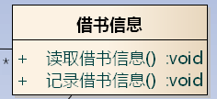


MVC Pattern
Model
View
Control

Slide 8
Entity Objects
Entity objects encapsulate the business data and business logic of the system.
also called model or business classes, are extracted directly from the statement of the problem (e.g., book).

Slide 9
Boundary Objects
are used to create the interface (e.g., interactive screen or printed reports) that the user sees and interacts with as the software is used.
As a rule, each actor/use case pair forms a boundary object in the analysis model.

Slide 10
Control Objects
manage a “unit of work” from start to finish. That is, controller classes can be designed to manage:
  the creation or update of entity objects;
  the instantiation of boundary objects as they obtain information from entity objects;
  complex communication between sets of objects;
  validation of data communicated between objects or between the user and the application.
As a rule, each use case has one control object

Slide 11
Describe Behavior
how the associated objects interact to realize the use cases.
UML uses two diagrams to describe the interactions between objects: sequence diagrams and collaboration diagrams.
Sequence diagrams show how objects interact over time.

Slide 12
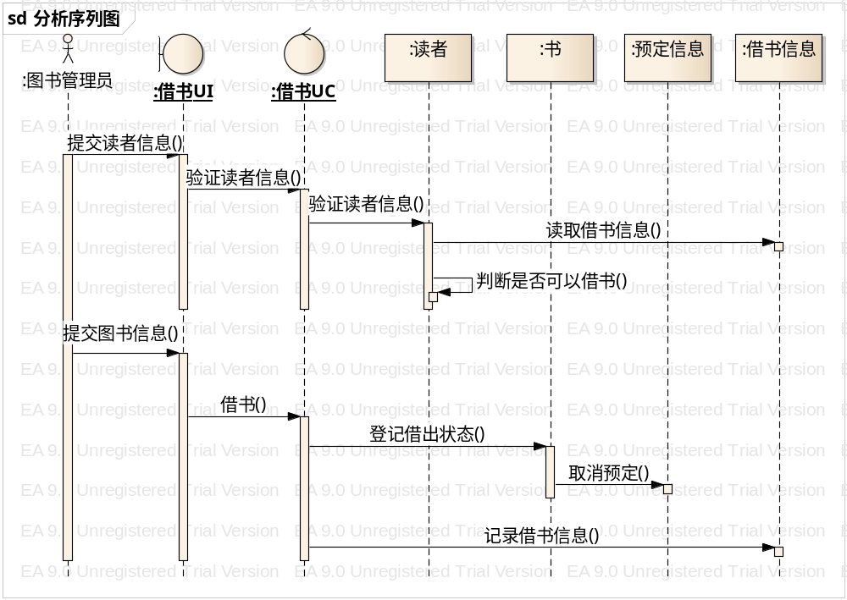
Describe Behavior

Slide 13
The Next Step---OOD
Decisions on technology to implement analysis classes into design class.
  Architecture choice
  Framework choice
  Language choice
  Data base design if it is necessary

Slide 14
OOD (continued)
No clear boundary between analysis and design: seamless.
Use mostly the same tools to describe design as used to describe analysis:
  Package diagram
  class diagram
  sequence diagram
  …

Slide 15
Design process
Categorizing analysis classes into:
  Boundary classes
  Control
  entity classes
Architecture
Framework
language

Slide 16
Boundary classes technology
Client or UI
Number of users
Deployment constraints
Complexity of UI

Slide 17
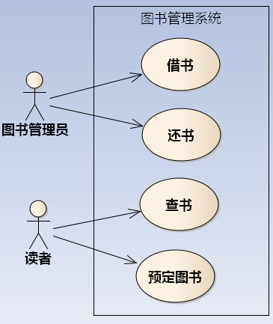
Boundary classes technology

Slide 18
Boundary classes for ongoing example
Each use case
  Lending/reuturn book: few users, deployment inside library: so we should choose winForm client
  Searching book: many users, deployment in Internet: so we should choose web browser, such as IE, as client.
  Subscribing book: similar to searching book
So we should choose n-tier architecture

Slide 19
Entity classes for ongoing example
Need persistent? Yes
So we need DB layer. And we can give the overall architecture topology:

Slide 20
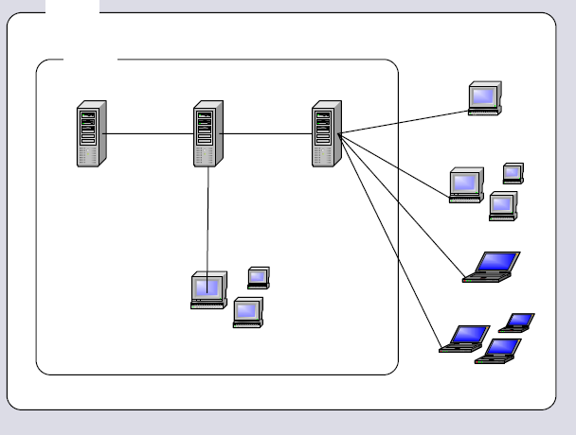
Topology of architecture chosen for ongoing examples
DB server
Application server
Web server
winForm
Web client

Slide 21
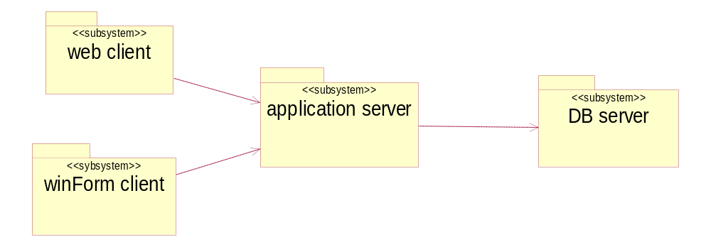
Logical architecture for ongoing example

Slide 22
Architecture and framework choice
Java EE
  Struts for webForm
  Java for winForm

Slide 23
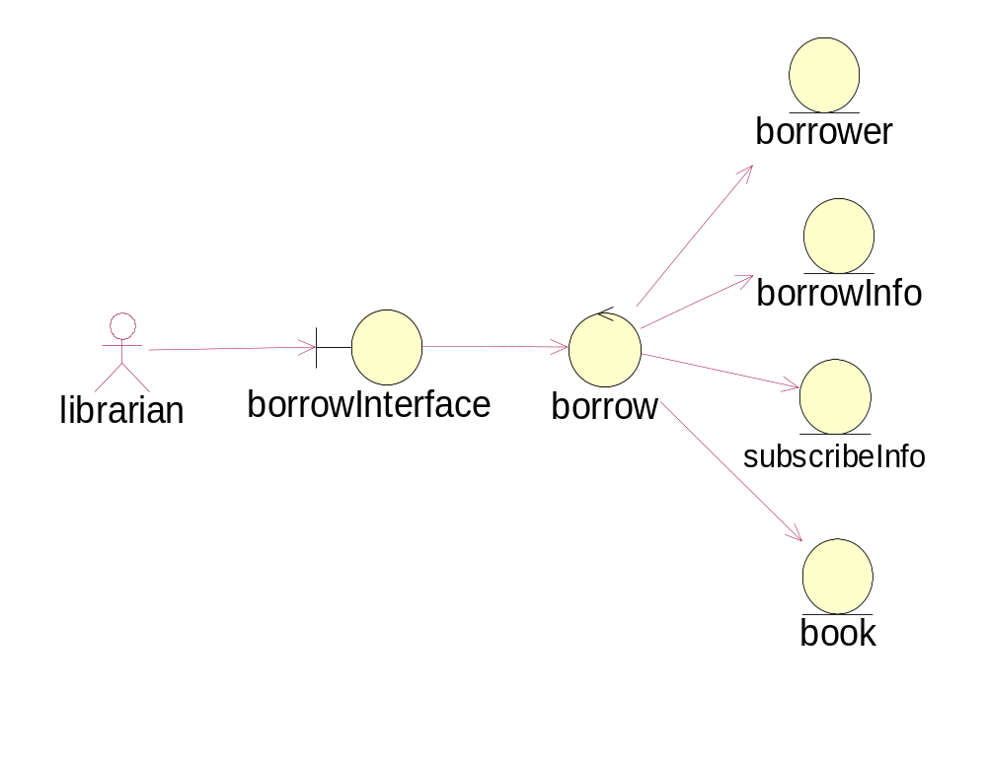
“Lending book” design

Slide 24
“Lending book” design
Assign these analysis classes into packages/subsystems
Refine these analysis classes into design classes
House these design classes into architecture and framework

Slide 25
Assign these analysis classes into packages

Slide 26
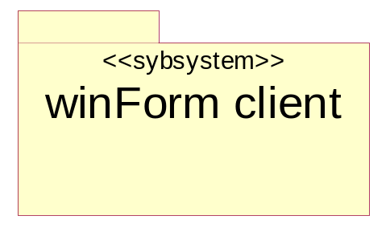
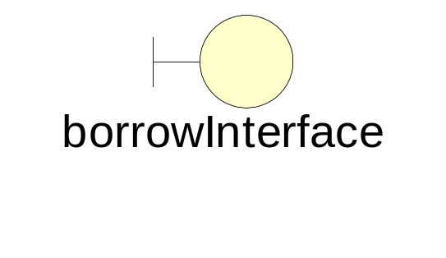
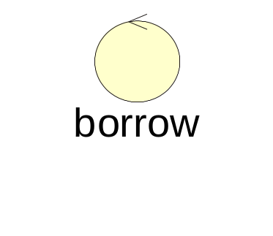
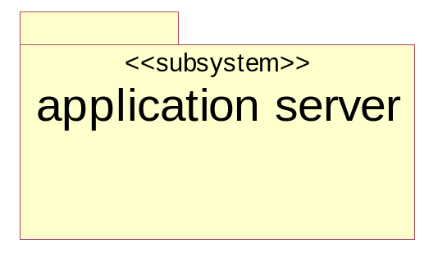
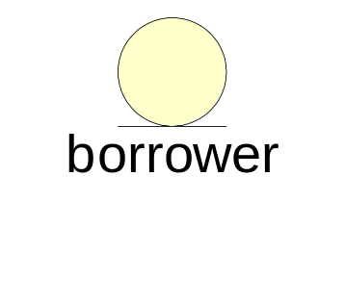
“Assign these analysis classes into packages (continue)
into
into

Slide 27
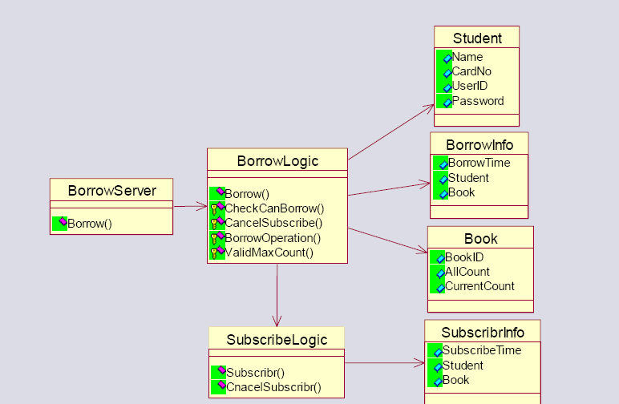
Application server design

Slide 28
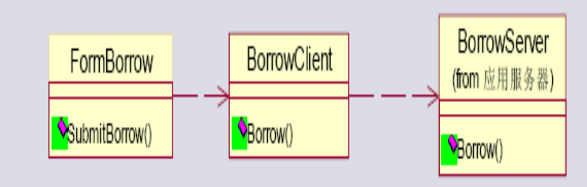
Client design

Slide 29
Others use cases
Search book
Subscribe book

Slide 30
DB design

Slide 31
Summary on OOD
OOA to OOD is seamless

